Slide 1

Home security and door control using rapid face detection method
Aditya Srinivas B - 122003016
Heshwa B - 122003091
Kkrish N A - 122003120
Guide
Dr. A. Suganya
Asst. Professor – II, CSE / SoC

Slide 2

Base Paper
Title: A fast face detection method via convolutional neural network
Year: 2019
Journal - Neurocomputing
Indexing - SCI
Publisher - Elsevier
Base paper URL: https://www.sciencedirect.com/science/article/abs/pii/S0925231219309075

Slide 3
Abstract
The detection speed is still the biggest bottleneck, which hinders the practical deployment of these face detectors on resource-limited platforms and can’t be used effectively in real-time applications.
Products nowadays require a faster response from the sensors to prevent something worse to happen.
Since many thefts have been happening, the security of homes is becoming vulnerable every day. To secure us from this, a camera can be fitted in the door’s peephole to detect and monitor according to users need.
If any movements of a person are detected in front of the door, it alerts the user and streams the live video, if the user requests.
Simultaneously this face detection model detects the face, captures a snap of their face and sends it to the user’s application. Then the user can take action from remote, whether to allow the person or not.

Slide 4
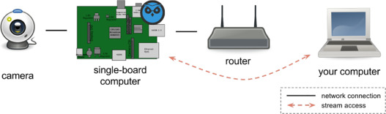
Proposed System
Implement the Face detection model into our home security system.
Whenever a person shows up, this model detects the person’s face sooner.
The detected face is then captured.
The image is then transferred to the user through Raspberry Pi computer via Internet.
The user receives a notification in mobile app.
He/she can control the door’s function to whether allow the person or not.

Slide 5

Methodology

Slide 6
Datasets
200 images from 256_object_categories -> people
100 images from AFW -> Wider -> images -> 1-Handshaking
3000 images CelebA dataset
1000 images from Kaggle (Natural_images)
5000 images from Sun et al -> train -> lfw_5590
1000 images from Sun et al -> train -> net_7876
Different amount of pictures used for training different models

Slide 7
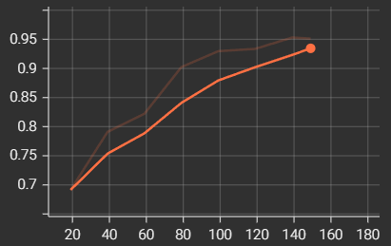
Accuracy
Accuracy : > 95 %
X-axis – No. of iterations
Y-axis - Accuracy

Slide 8
Comparison

Slide 9

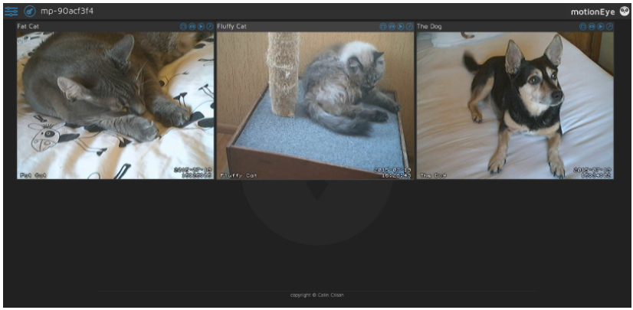

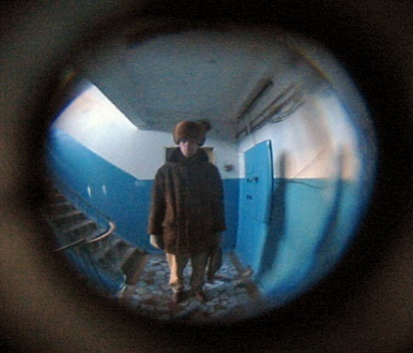

App
Control the door
See history of detections.
SOS feature
Add many doors
Address of the user
Door 1
Door 2
Door 3

Slide 10
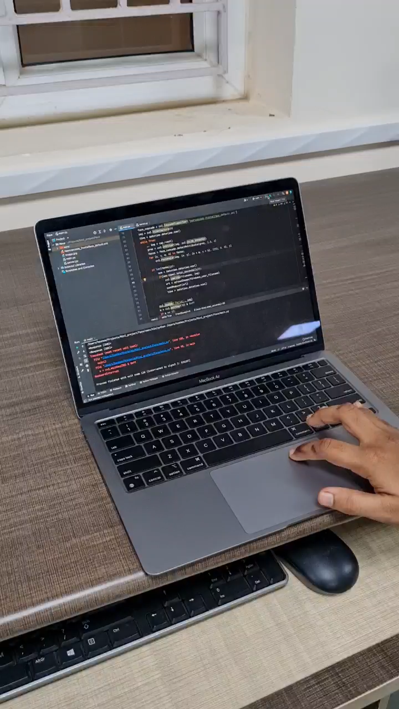
Core functioning
Face detection detects the face
Picture is taken when person steps in front of door
Sent to the user as notification
User uses the app to control the door’s action
Appropriate action is taken by the user.
The action is recorded in history log with the picture
SOS feature can be used when user finds it skeptical

Slide 11
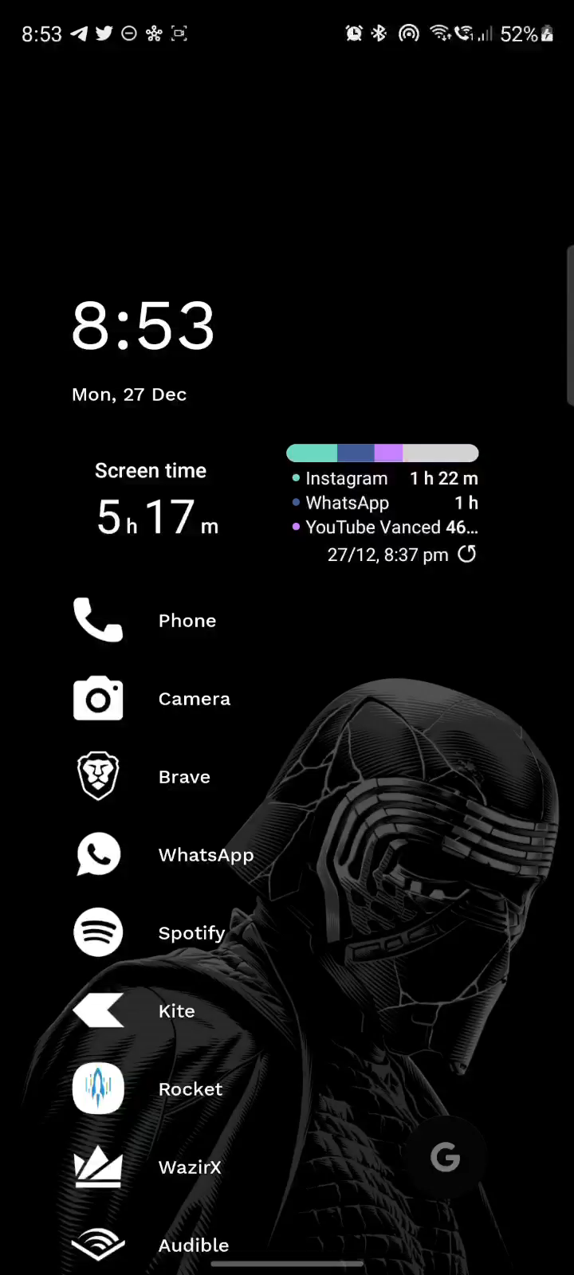
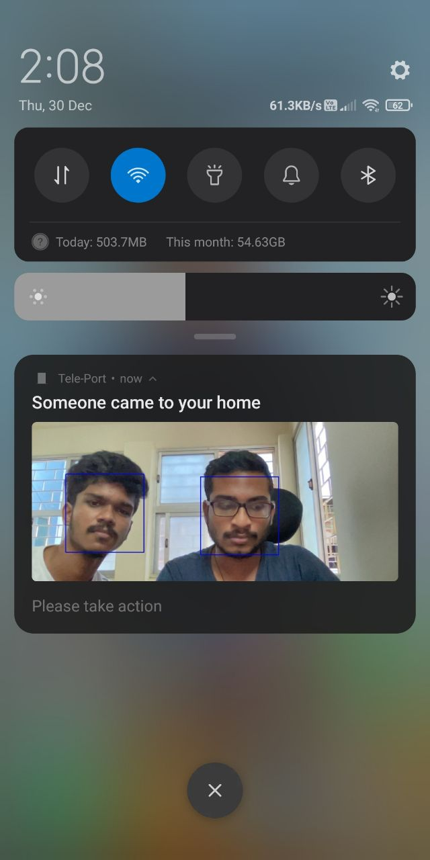
Entire functioning
SOS
Specify Address
Add many doors
Notifications
Emergency contact
History

Slide 12
Future Work Plan
Face recognition
Mic and Speaker set-up
Adding features in app
Extending SOS feature

Slide 13
Literature survey
Title | Work | Method | Year
Face detection using deep learning: An improved faster RCNN approach | A new face detection scheme using deep learning and achieve a good detection performance on the well-known FDDB face detection benchmark evaluation. | Improved by combining many strategies including feature concatenation, hard negative mining, multi-scale training, model pre-training, and proper calibration of key parameters. | 2018, Neurocomputing, Elseveir
Face Detection with the Faster R-CNN | Applying the Faster RCNN, which has recently demonstrated impressive results on various object detection benchmarks, to face detection. | By training a Faster R-CNN model on the large scale WIDER face dataset, we report best results on the WIDER test set and also in FDDB benchmarks. | 2017, IEEE Explore
Access Control and Surveillance in a Smart Home | Two IoT based systems in the context of Smart homes: qToggle for multiple home automation, and MotionEyeOS, a video surveillance OS for single-board computers | Most qToggle Devices are based on ESP8266/ESP8285 chips or on Raspberry Pi boards and smart sensors, while MotionEye uses Raspberry Pi boards. | 2021, Elseveir

Slide 14
References
H. Jiang, E.G. Learned-Miller, Face detection with the faster R-CNN, CoRRabs/1606.03473 (2016)
R. Girshick, Fast R-CNN, in: Proceedings of the IEEE Conference Computer Vision and Pattern Recognition, 2015, pp. 1440–1448
Cristina Stolojescu-Crisan, Access Control and Surveillance in a Smart Home, (2021), High-Confidence Computing, pp. 100036
Waheb A. Jabbar, Design and Fabrication of Smart Home With Internet of Things Enabled Automation System, in: IEEE Access (Vol: 7), (2019), pp. 144059 – 144074

Slide 15
Thank you !

